Slide 1
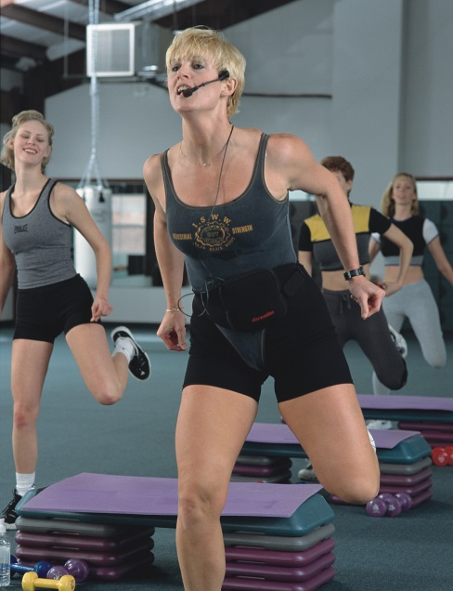
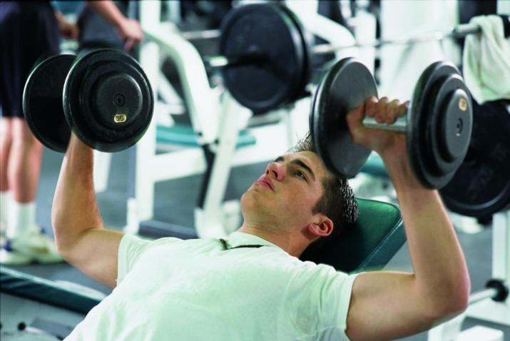



Version 1.1A
© 1995 - 2020 by IFA www.ifafitness.com
Fitness Instructor Certification Seminar

Slide 2

Foreword
Please consult your doctor before starting a rigorous exercise program.
Muscle soreness is normal, but pain is NOT.
Working too many times a week is damaging to your muscles.
Nutrition is important for fuel to work and repair.
The material covered in this presentation will allow you to certify as an:
  Group Fitness Instructor
  Personal Trainer
  Sports Nutritionist
  Senior Fitness Instructor
  Aqua Fitness Instructor
Please use common sense when continuing your exercise program, for any questions or concerns please contact IFA at
407-579-8610 or www.ifafitness.com

Slide 3

Nutrition
Macronutrients
Micronutrients
Daily Caloric Requirements
USDA MyPyramid Food Table
Image courtesy of stockimages at FreeDigitalPhotos.net

Slide 4

Macronutrients
Proteins
Non-Essential Amino Acids
Essential Amino Acids
Carbohydrates
Fats
Water
Image courtesy of Apolonia at FreeDigitalPhotos.net

Slide 5

Micronutrients
Vitamins
Minerals
Additional Supplements

Slide 6
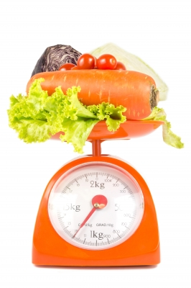
Daily Caloric Requirements
BMR
Protein Dietary Requirements
Carbohydrate Dietary Requirements
Fat Dietary Requirements
Image courtesy of mikumistock at FreeDigitalPhotos.net

Slide 7
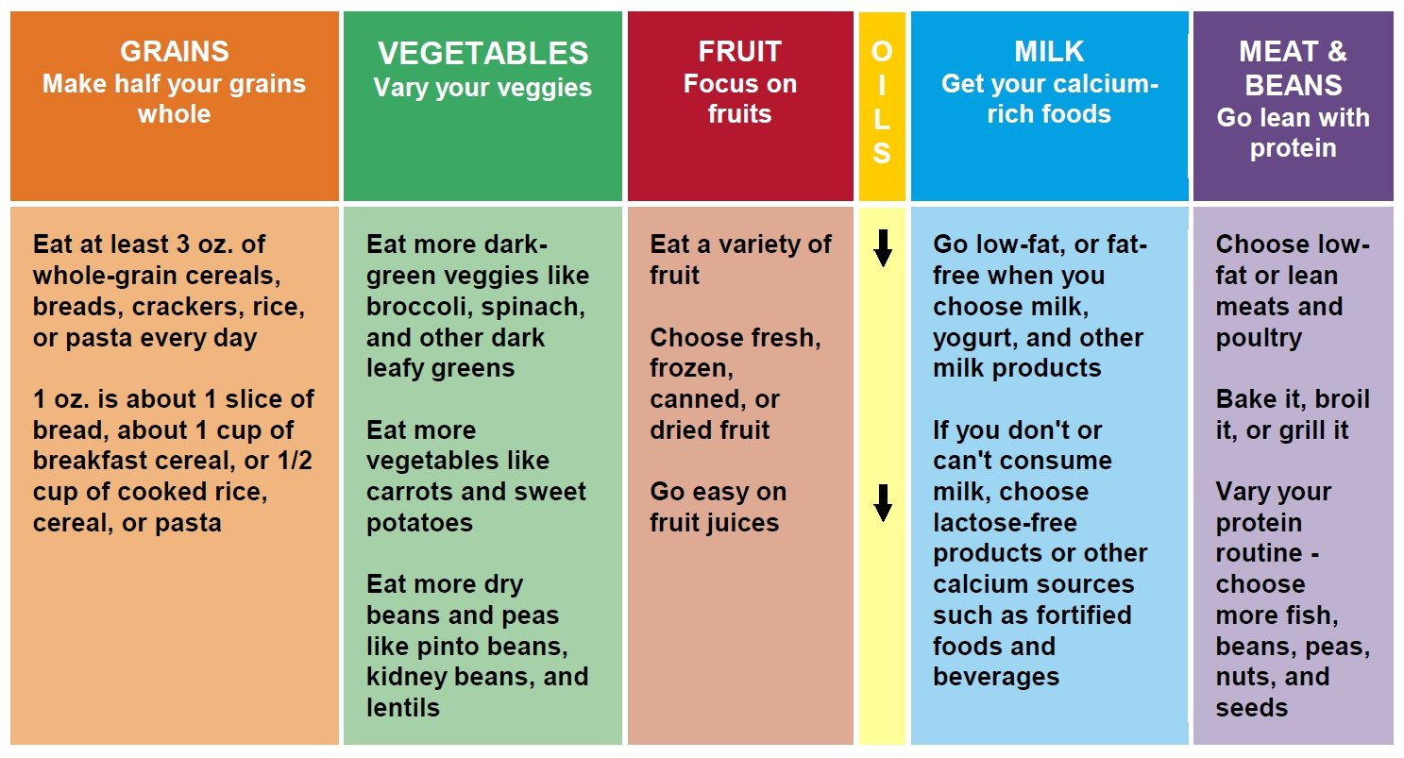
USDA MyPyramid Food Table
www.MyPyramid.gov

Slide 8
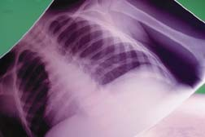
Physiology
Muscle Fiber Types
Energy Production
Cardiovascular and Respiratory System

Slide 9
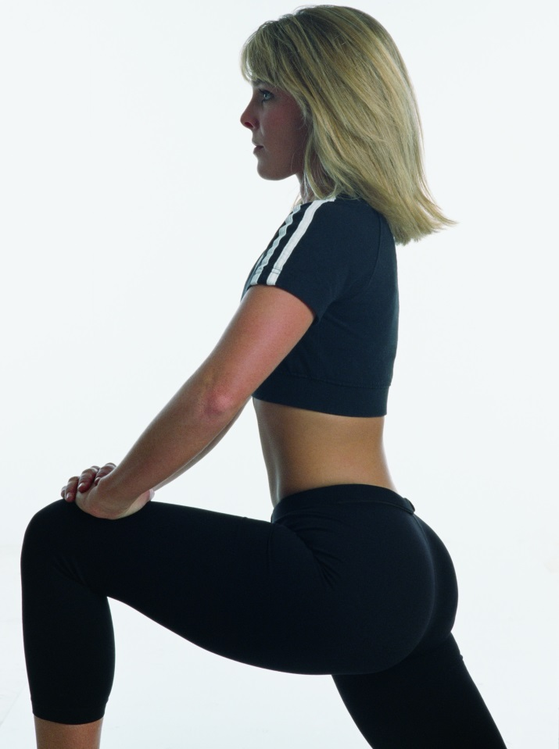
Kinesiology
Anatomy
Muscle Action
Joint Action

Slide 10

Aerobic Training
Benefits
Weekly Requirements and Limitations
Diet Requirements
Types of Aerobic Activities
Pregnancy
Image courtesy of Photostock at FreeDigitalPhotos.net

Slide 11

Aerobic Training
Maximum Heart Rate (MHR)
Resting Heart Rate
Target Heart Rate
Heart Rate Reserve
Standard Metabolic
Equivalent (MET)
Image courtesy of Stuart Miles at FreeDigitalPhotos.net

Slide 12
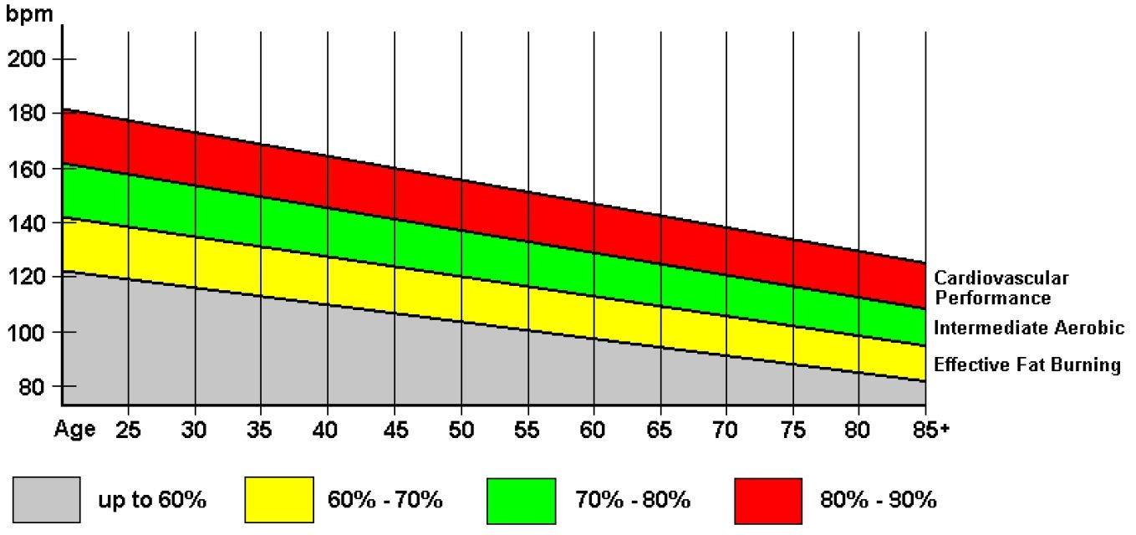
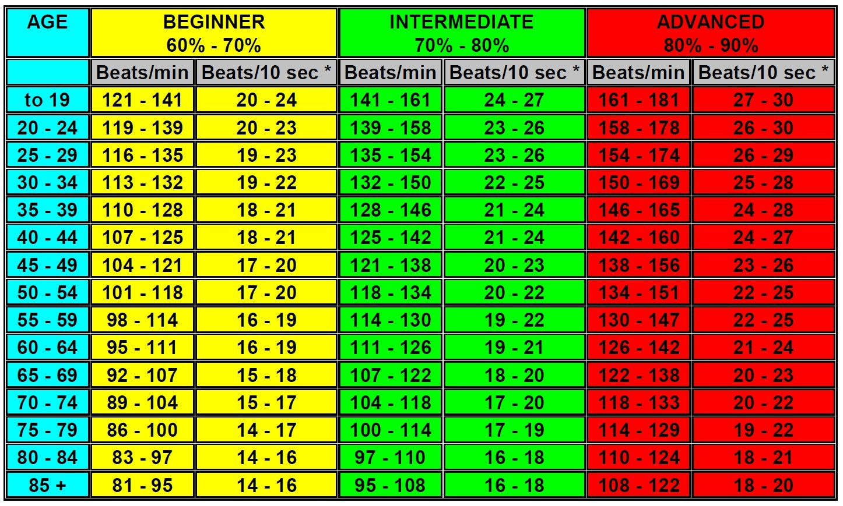
Target Heart Rate Chart/Table

Slide 13

Aerobic Training
Recovery Heart Rate
Rating of Perceived Exertion (RPE)
Blood Pressure
Proper Attire for Specific Activity
Image courtesy of digitalart at FreeDigitalPhotos.net

Slide 14

Specific Aerobic Activities
Running
  Use a good running shoe.
  Land on the heel and rotate to
  the toe, except when sprinting
  stay on toes.
  Use orthotic inserts if necessary.
  Restrict vertical movement,
  don't slam down, and glide.
Image courtesy of stockimages at FreeDigitalPhotos.net

Slide 15
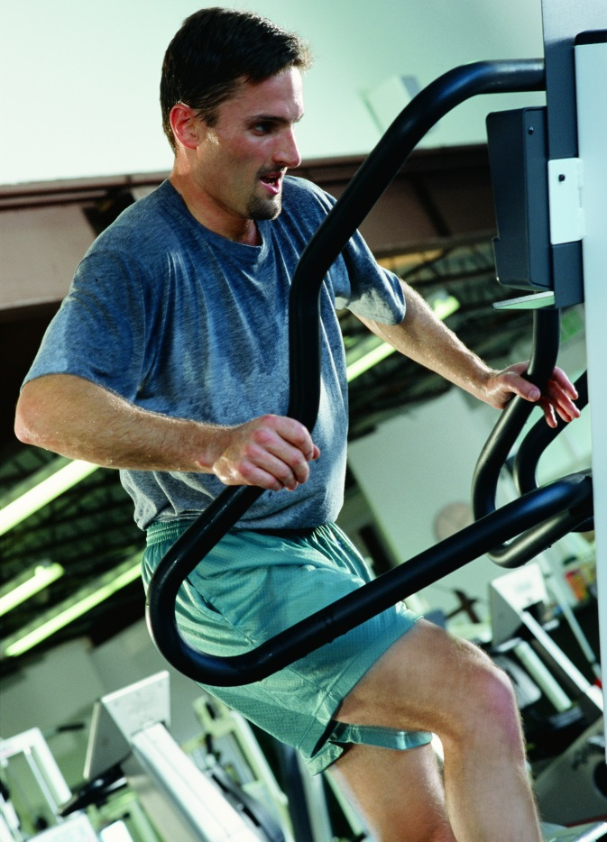
Specific Aerobic Activities
Stair Master
  Use the handrails for balance
  only, not for support.
  Keep back and head straight up
  in vertical alignment.
  Using 8 to 10 inch step strokes
  uses 15% more energy.

Slide 16
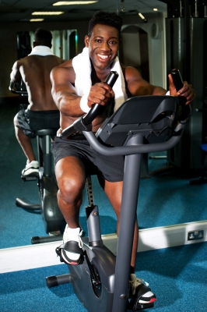
Specific Aerobic Activities
Stationary Bicycle
  Restrict side flex movement.
  Assume upper body slightly
  forward with head upright.
  Adjust seat for near full
  leg extension.
Image courtesy of stockimages at FreeDigitalPhotos.net

Slide 17
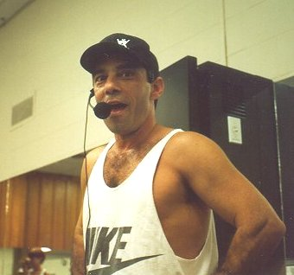
Teaching Aerobics
Class Preparation
Intensity and Complexity
Components of an
Aerobics Class

Slide 18
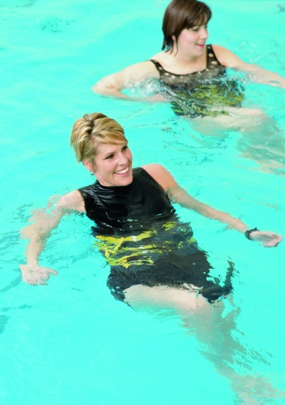
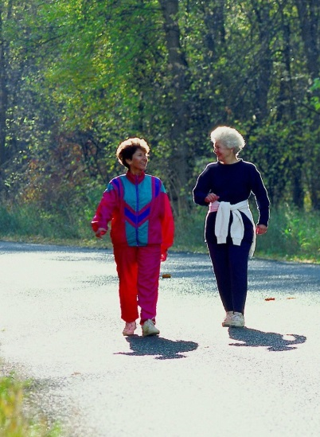
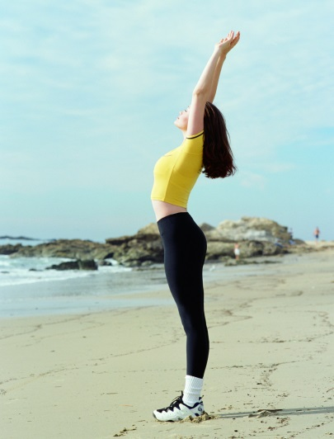


Types of Classes
High Impact Aerobics
Low Impact Aerobics
Mid-Tempo Aerobics
Step Aerobics
Super Step Aerobics
Interval
Circuit
Warm-up
Cardio
Post-Cardio
Cool Down

Slide 19
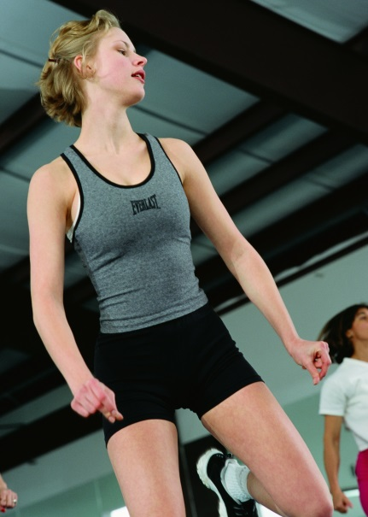
Choreography
32-Count Phrase
To build a 32-count combination, choose 4 moves that go together
  An example of 4 moves might be:
    1. Step - touch
    2. Step - hamstring
    3. Grapevine
    4. Jumping jacks
Now that you have 4 moves that go together,
perform each move for 8 counts.

Slide 20
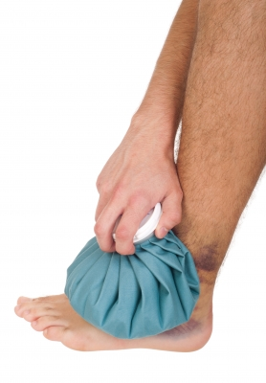
Injury Prevention
Watch for fatigue
Watch for falls or injury
Watch for cardiovascular or respiratory difficulty
Sprains are treated with Rest, Ice, Compression and Elevation (RICE)
Shin Splints
Image courtesy of artur84 at FreeDigitalPhotos.net

Slide 21

Step Aerobics – The Basics
Bring foot flat up and centered on board to avoid board instability.
Do not hang heels off the board to avoid straining the Achilles tendon.
Lower toes to the floor first then heel when coming off board to absorb shock.
Keep within 12 inches of board when coming to
floor, except during lunges.
Keep heel off the floor when doing lunges, keep
weight on the ball of the foot.
Power up onto to the board only, don't jump
off board.

Slide 22
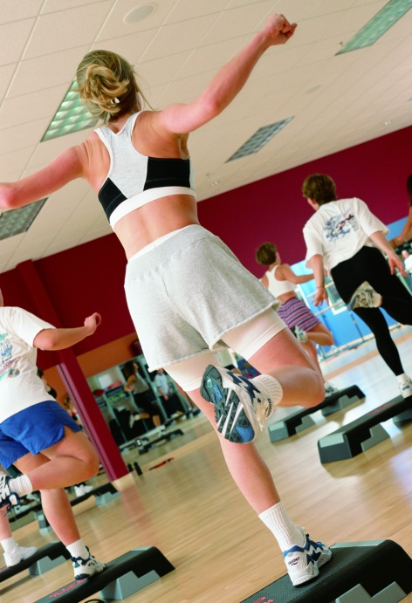
Step Aerobics – The Basics
Lean from the ankles, not the hip.
Keep abdominals tight to improve muscle
tone and balance.
Continue breathing, never hold the breath.
Knees should be soft not locked to provide
shock absorption and reduce back strain.
Keep hands on waist until comfortable with
leg movements, when learning coordination.

Slide 23
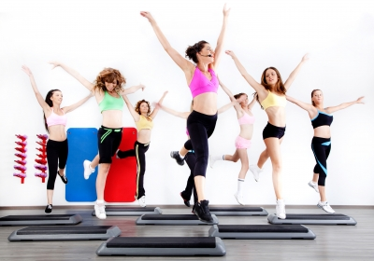
Step Aerobics – The Class
Warm-Up
General Technique
Safety
Image courtesy of Photostock at FreeDigitalPhotos.net
Discontinue stepping if:
  Legs become fatigued and uncoordinated.
  Any pain becomes evident.
  Dizziness occurs.
  Rapid heart rate

Slide 24
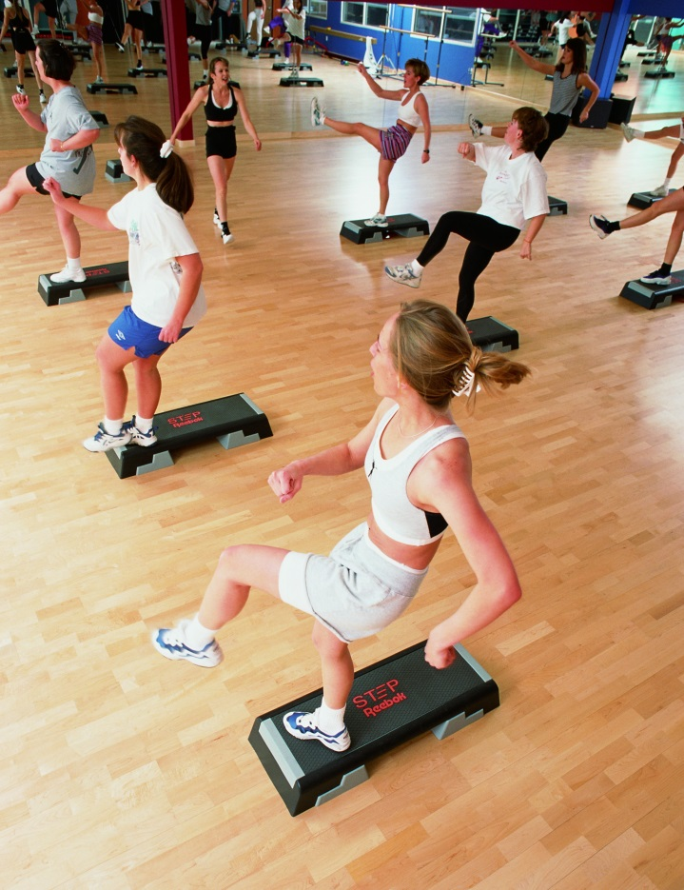
Basic Step Moves
Basic Left (Reverse for Basic Right)
V-Step
A-Step
Turn-Step
Z-Step
X-Step

Slide 25

Kickboxing Aerobics – The Class
Warm-Up
General Technique
Boxer’s Stance Technique
Safety
Discontinue Kickboxing Aerobics if:
  Legs become fatigued and uncoordinated.
  Any pain becomes evident especially joint pain.
  Shin area pain or discomfort.
  Dizziness occurs.
  Rapid heart rate.
Image courtesy of Ambro at FreeDigitalPhotos.net

Slide 26
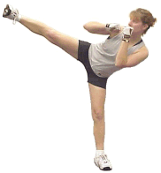
Kickboxing Aerobics – Basic Moves
The Jab Punch
The Round House Punch
The Power Punch
The Left Hook Punch
The Front Kick – Forward Leg
The Front Kick – Rearward Leg
The Side Kick – Left Kick (reverse for Right Kick)
The Round House Kick

Slide 27
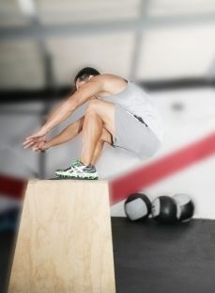
Plyometric Training
Benefits
  Improves muscle response time
  Increases muscle performance
  Tones muscles
  Improved balance and posture
  Increases flexibility, reducing
  capability for injury
Image courtesy of David Castillo Dominici at FreeDigitalPhotos.net

Slide 28

Aqua Training
Land vs Water Exercise
Benefits
Cautions
Teaching Style
Technique

Slide 29

Aqua Training
Water
Safety
Heart Rates
Equipment
The Class

Slide 30

Weight Training
Benefits
  Helps control blood pressure
  Reduces body fat
  Improves posture
  Increases muscle strength
  Raises Basal Metabolic Rate
  Increases bone density
  Injury prevention from normal activities
  Physical appearance

Slide 31
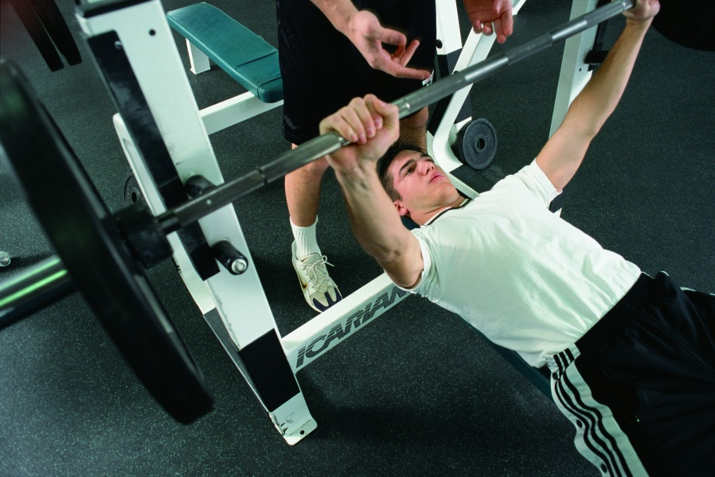
Weight Training
Circuit Training
Overload Principle
Specificity Principle
Free Weights vs. Machines
Proper Lifting Technique
Sets and Repetitions
Variations of Sets and Repetitions
Weekly Requirements
Diet Requirements

Slide 32
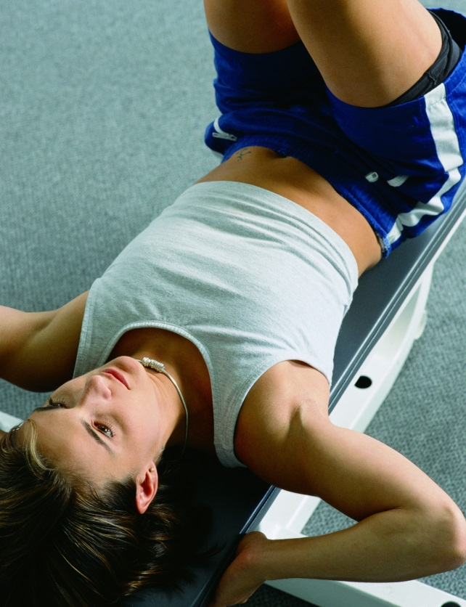
Muscle Exercise Cross Reference
Exercise sessions should be organized so that the larger muscle groups are exercised first, followed by the smaller muscle groups.
The order of groups should be as follows:
Abdomen Hips and lower back Upper Legs Calves Chest Upper back | Shoulders Triceps Biceps Waist Neck

Slide 33

Sample Workout
Begin each workout with a warm-up. This can be 30 minutes of brisk paced walking or jogging, stair master, etc. Abdominals are done every day using 300 crunches with alternating movements.
Intermediate Workout:
  Do the following exercises in 3 sets of 12 reps.
Advanced Workout:
  Do the following exercises in
  4 sets of 12 reps, with increasing
  weight each set.
Image courtesy of Stuart Miles at FreeDigitalPhotos.net

Slide 34
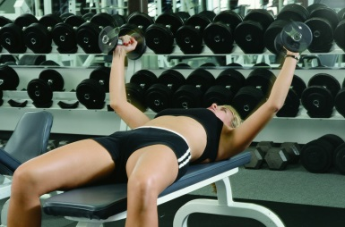

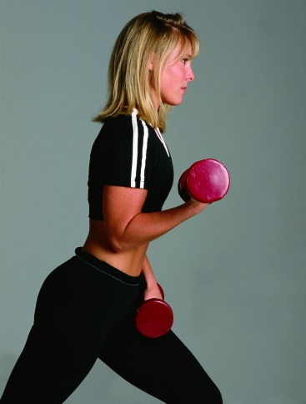

Sample Workout
Monday Legs: • Squats • Leg Extensions • Hamstrings • Abductor and Adductor Muscles • Calf Raises Biceps: • Straight Bar Curls • Dumbbell Curls • Drop Sets
Tuesday Chest: • Incline Dumbbell Press (upper) • Decline Dumbbell Press (lower) • Bench Press • Dumbbell Flyes Triceps: • Triceps Extensions • Triceps Pull-downs • Triceps Kickbacks • Triceps Press
Image courtesy of tiverylucky at FreeDigitalPhotos.net

Slide 35

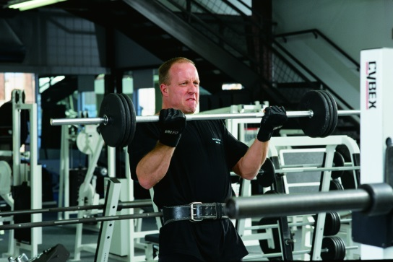
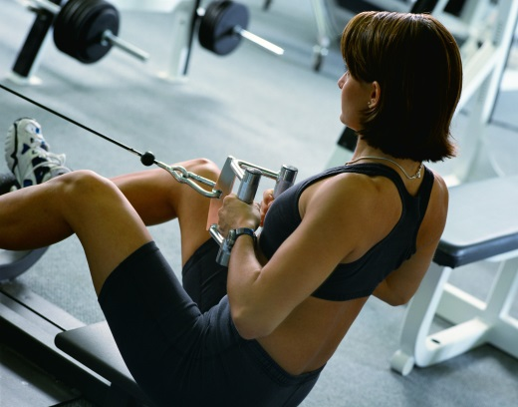
Sample Workout
Wednesday Shoulders: • Military Press • Dumbbell Rear Deltoid • Dumbbell Lateral Raises • Cable Raises Back: • Seated Rows • Lat Pull-downs Back • Lat Pull-downs Front • Dumbbell Lat Pulls
Thursday Trapezius: • Shrugs Forearms: • Forearm Curls • Any grip exercise Gluteus Maximus: • Cable kick backs
Image courtesy of
Stockimages at
FreeDigitalPhotos.net

Slide 36

Sample Workout
Friday Legs, Chest and Triceps: • Legs: Sled • Chest: Bench • Triceps: Barbell Extensions
Saturday Shoulders, Back and Biceps: • Shoulders: Military Press • Back: Sit-up Row Machine (rear deltoids) • Biceps: Dumbbell Curls
For Friday and Saturday do four (4) sets of twelve (12) reps
pyramiding the weight as heavy as you can.
Image courtesy of phanlop88 at FreeDigitalPhotos.net

Slide 37

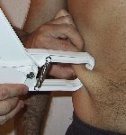
Fitness Testing
Flexibility Test
One-Minute Sit-Up Test
Pushup Test
Three-Minute Step Test
Body Composition
  Durnan Method
Image courtesy of digitalart at FreeDigitalPhotos.net

Slide 38

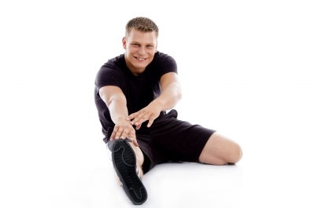
Stretching
Benefits
Types of Stretching
Precautions
Image courtesy of Serge Bertasius Photography
at FreeDigitalPhotos.net
Image courtesy of imagerymajestic at FreeDigitalPhotos.net

Slide 39


Yoga
Benefits
  Relaxation
  Increased Flexibility
  Increased Respiration
  Increased Circulation
  Self-Awareness
Requirements
Guidelines
Image courtesy of Ohmega1982 at FreeDigitalPhotos.net
Image courtesy of Ambro at FreeDigitalPhotos.net

Slide 40

Pregnancy
General Information
Aerobic Training
Weight Training
Trimester Specific
Exercises
Nutrition
Post Pregnancy
Image courtesy of patrisyu at FreeDigitalPhotos.net

Slide 41
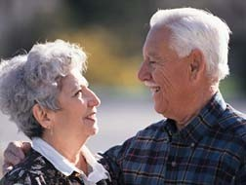
Senior Fitness
The American College of Sports Medicine (ACSM) stresses the importance of strength training for older people. ACSM recommends that seniors begin an exercise program with strength training before they start an aerobic training program.
The purpose of this section is to increase the Fitness Instructor's understanding of the physiological and as well as the psychological changes that occur during the aging process. This will allow the instructor
to develop an effective and safe fitness
program specifically for the senior
population. Senior classification varies
according to who you ask.
Generally, seniors are considered to be
those that are 55 and older.

Slide 42

Physiological Effects of Aging
Cardiovascular Effects
Respiratory Effects
Muscular Effects
Skeletal Effects
Digestive System Effects
Endocrine System Effects
Nervous System Effects
Immune System Effects
Image courtesy of dream designs at FreeDigitalPhotos.net

Slide 43

Senior Fitness Testing
Balance Testing
Cardiovascular Testing
Strength Testing
Flexibility Testing
Image courtesy of stockimages at FreeDigitalPhotos.net

Slide 44

Senior Training
Warm-up exercise
Aerobic Training
Strength Training
Balance Training
Flexibility Training
Image courtesy of stockimages at FreeDigitalPhotos.net

Slide 45

Exercise Injury
Introduction
  This following information is not to be used for self-diagnosis. It's primary intent here is for identification purposes in order to provide first-aid care or to help understand a medical professional's diagnosis. A medical professional always should be consulted in all cases of injury or suspected injury. Symptoms may appear to indicate one type of injury but may in fact be an indication of a more serious injury.
Acute Injury
Chronic Injury
Overuse Injuries
Chondromalacia and Patellofemoral Syndrome
Plantar Fasciitis and Neuromas
Tendonitis, Arthritis, Bursitis
Shin Splints and Compartment Syndromes
Breathing Reactions
Environmental Concerns
Image courtesy of stockimages at FreeDigitalPhotos.net

Slide 46
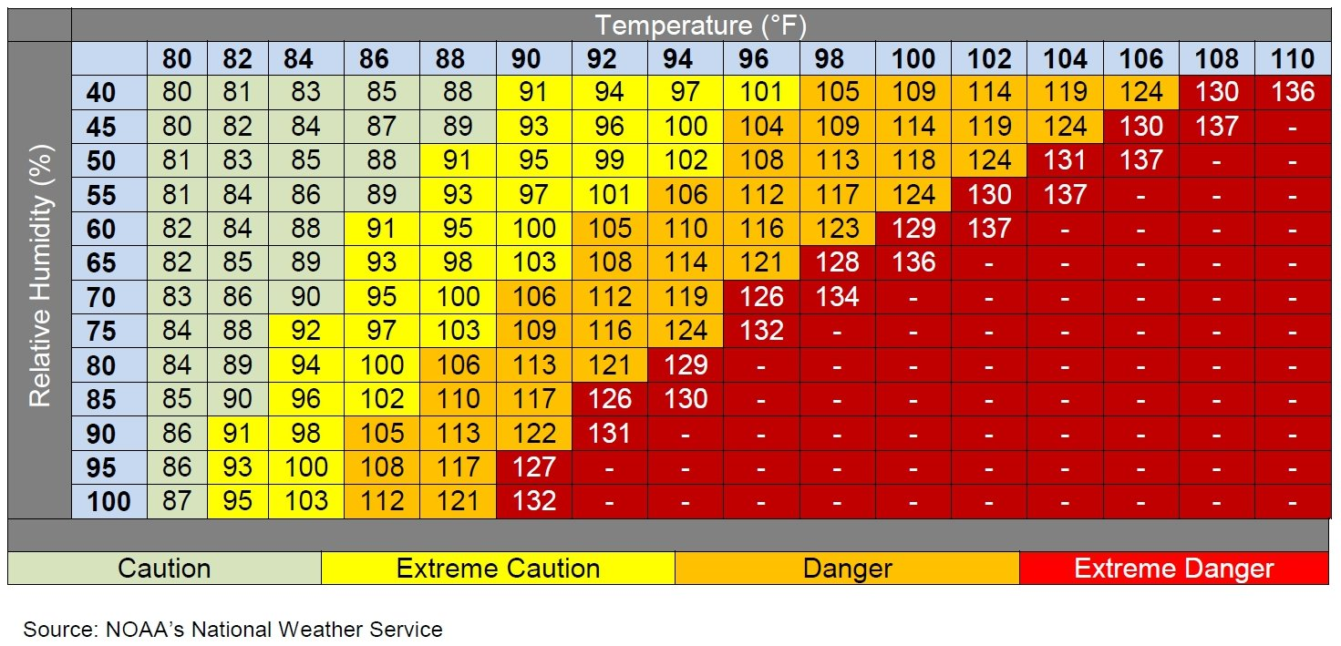
Heat Related Injuries
Heat Index

Slide 47

Heat Related Injuries
Heat Cramps
Heat Exhaustion and Heat Stroke
Emergency Response
Temperature and Humidity
Hypothermia and Frostbite
Image courtesy of digitalart at FreeDigitalPhotos.net

Slide 48
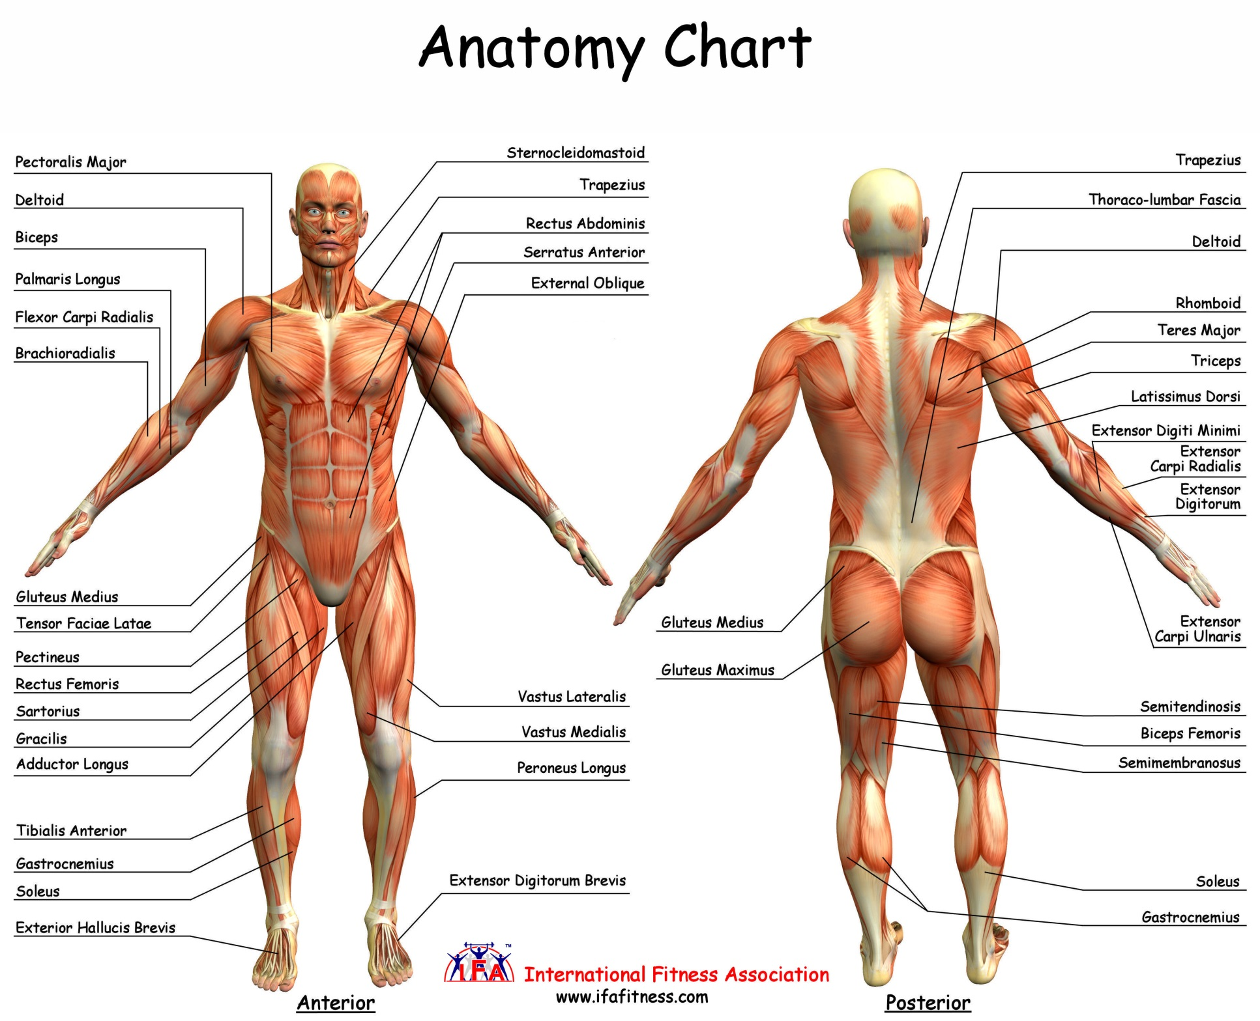

Slide 49
References
ACSM, ACSM's Guidelines for Exercise Testing and Prescription, Sixth Ed. New York, Lippincott Williams & Wilkins, 2000
Avellini, B. A., Shapiro, Y., & Pandolf, K. B.Cardio-Respiratory Physical Training in Water and on Land European Journal of Applied Physiology and Occupational Physiology, (1983) 50, 255-263.
Baechle, Thomas, Ed. D, CSCS. Weight Training Instruction: Steps to Success Champaign, IL: Human Kinetics, 1994.
Benowieez, Robert. Vitamins & You. New York: Berklett books, 1981
Blanche, W., Evans, W., Cureton, K. J., & Purvis, J. W. Metabolic and circulatory responses to walking and jogging in water Research Quarterly, (1978) 49, 442-449.
Borton, Benjamin. Human Nutrition. New York: McGraw-Hill, 1978
Bosco, Dominick. The People's Guide to Vitamins & Minerals. Chicago: Contemporary Books, 1980
Briggs, Paula. The Physically Challenged. Aquatic Exercise Association Aquatic Fitness Professional Manual, (2003): 320.
Carper, Jean. Jean Carper's Total Nutrition Guide. New York: Bantam Books, 1989.
Cohen, BM. Lecithin in Mania. A Preliminary Report. American Journal of Psychiatry 137(2) 242-3, February, 1980
Craig, A.B. and Dvorak, A.M. Thermal regulation of man exercising during water immersion. Journal of Applied Physiology, 25 (1968): 23-5.

Slide 50
References
Coon, Nelson. Using Plants for Healing. Emmaus, PA: Rodale Press. 1979
Conner, William MD. Fruit of the Seas May Foil Cardiovascular Disease. Medical News. February 12, 1982 (729-733)
Copeland, C. et al. Power Step Reebok. Boston, MA: Reebok International, Ltd, 1992.
Costill, D., et al. Effects of Caffeine Ingestion on Metabolism and Exercise Performance Medical Science Sports Exercise 1978.
DiPrampero, P.E. The energy cost of human locomotion on land and in water. International Journal of Sports Medicine, 7, no. 2 (1986): 55-72.
Francis, L., et al. Introduction to Step Reebok Boston, MA: Reebok International, Ltd, 1991.
Gibney, Michael. Nutrition Diet & Health New York: Cambridge University Press, 1986.
Gottlieb, William. The Complete Book of Vitamins. Emmaus, PA: Rodale Press, 1984
Grant, Norman. Resistive Weight Training Dubuque, IA: 1993
Herbert,Victor, M.D. Total Nutrition, The Only Guide You'll Ever Need New York: St. Martin's Press, 1995.
Humphries, Debra, et al. Step Fitness Basics, Instructor Resource Guide. St. Paul, MN: National Fitness Association of America, 1992
Jordan, Peg, RN (Ed.). Fitness Theory and Practice. Sherman Oaks, CA: Aerobics and Fitness Association of America, Stoughton, MA: Reebok University Press, 1993

Slide 51
References
Kadans, Joseph. Encyclopedia of Medicinal Herbs. New York: Arco Publishing, 1984
Kirschmann, John. Nutrition Almanac. New York: McGraw-Hill, 1984
Komi, P. V., Editor, Strength And Power In Sport Blackwell Scientific Publications, London, 1992.
Mazzeo, Karen, M. Ed., A Committment to Fitness Englewood, CO: Morton Publishing Co, 1985.
McArdle, Katch, Katch. Exercise Physiology. Williams & Wilkins, Baltimore, MD, 1996, ISBN 0-683-05731-6
McCarty, Mark. Health Benefits of Supplemental Nutrition. San Diego, CA Nutri Guard Research,1985
Miller, David, et al. Fitness A Lifetime Commitment. New York: Macmillan Publishing Co., 1986.
Mindel, Earl. Vitamin Bible. New York: Warner Books, 1985. NOAA, National Weather Service, http://www.nws.noaa.gov, 2012
Pop-Cordle, Jamie, M.S., R.D. and Martin Katahn, Ph.D. The T-factor Fat Gram Counter. New York: W. W. Norton & Company, 1994.
Piscopo, John. Fitness and Aging New York: Macmillan Publishing Co., 1995.
Razdan & Pettersson, Br. J. The ARS Medicina Report on Chitosan Helsinki, Finland, 1994
Reid, J. Gavin, et al. Exercise Prescription for Fitness Englewood Cliffs, NJ: J. Prentice Hall, Inc., 1985.

Slide 52
References
Richie, S. E., & Hopkins, W. G. The Intensity of Exercise in Deep-Water Running International Journal of Sports Medicine, (1991) 12, 27-29
Ritchinson, Jack. The Little Herb Encyclopedia. Orem, Utah: Bi World Publishers, 1995
Scmidtbleicher, D., Strength Training, Part I & II SPORTS, Coaching Association of Canada, Aug., 1985.
R. Rikli, C. Jones, Senior Fitness Test Manual Champaign, IL: Human Kinetics, 2001.
Thomas, David G., Swimming: Steps to Success Human Kinetics, 2005 Tierra, Michael. The Way of Herbs. New York: Washington Square Press, 1983
Shin, Tae Won, et al, Are hot tubs safe for people with treated hypertension?
Canadian Medical Association Journal, Dec. 2003
Images, submitted by author displayed, http://www.freedigitalphotos.net

